Slide 1
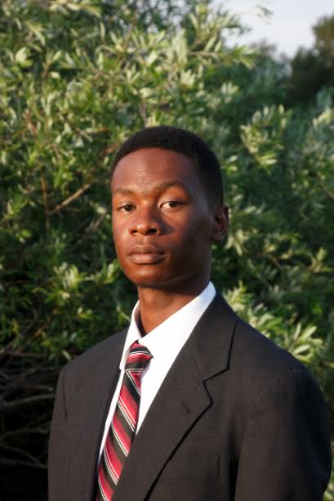


2nd Annual Undergraduate Quantitative Biology Summer School
Module 3: Introduction to Stoichiometry and Propensity Functions
Instructor: Joshua Cook, Michael May
e-mail:
jcook10@colostate.edu
michelpmay@live.com

Slide 2
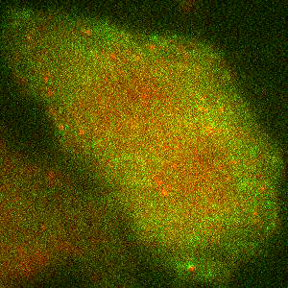
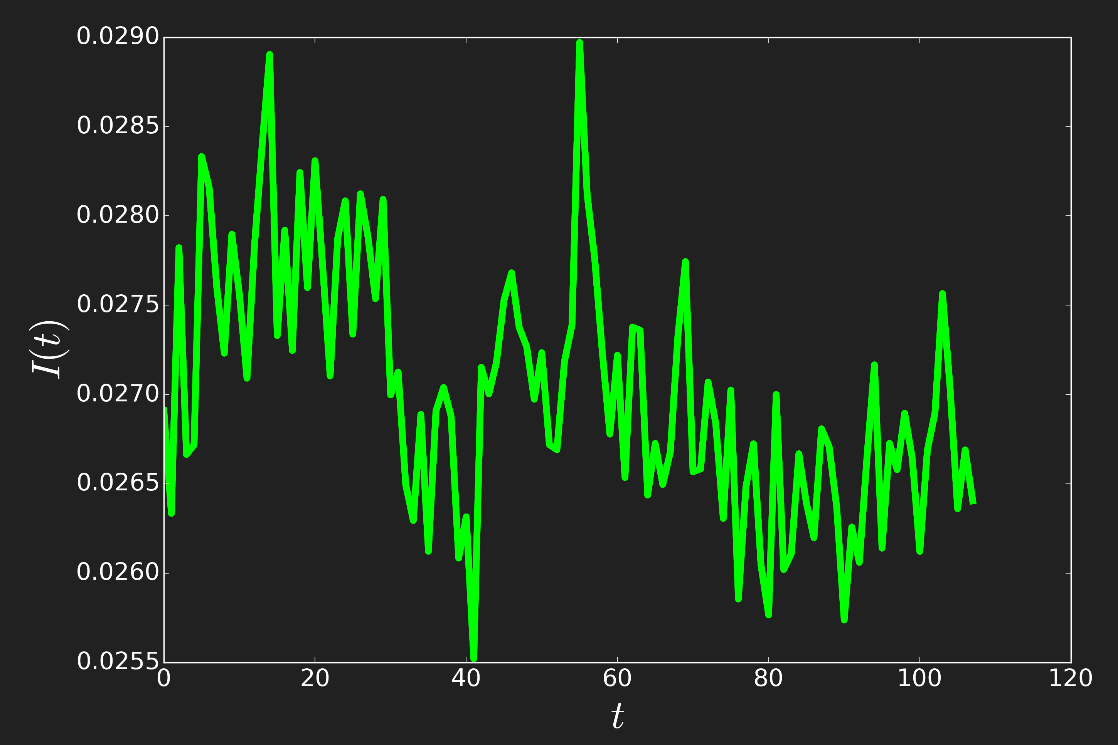

Imaging translation at single molecule resolution
Motivation
Outline
Motivation & Intro
Mechanistic Model
Reaction Stoichiometry
Reaction Propensity
Law of Mass Action
Putting it all Together
Final Notes
Example 1
Example 2
Example 3
Example 4
What changes in a chemical reaction?
How quickly does it change?
FLAG TAGS
Nascent Protein
Spaghetti monster
Ribosome
RNA
MS2 Hairpins
Spaghetti Monster
Protein of Interest
MS2-mCherry
Intensity signals of nascent protein display fluctuations over time due to underlying transcription dynamics

Slide 3
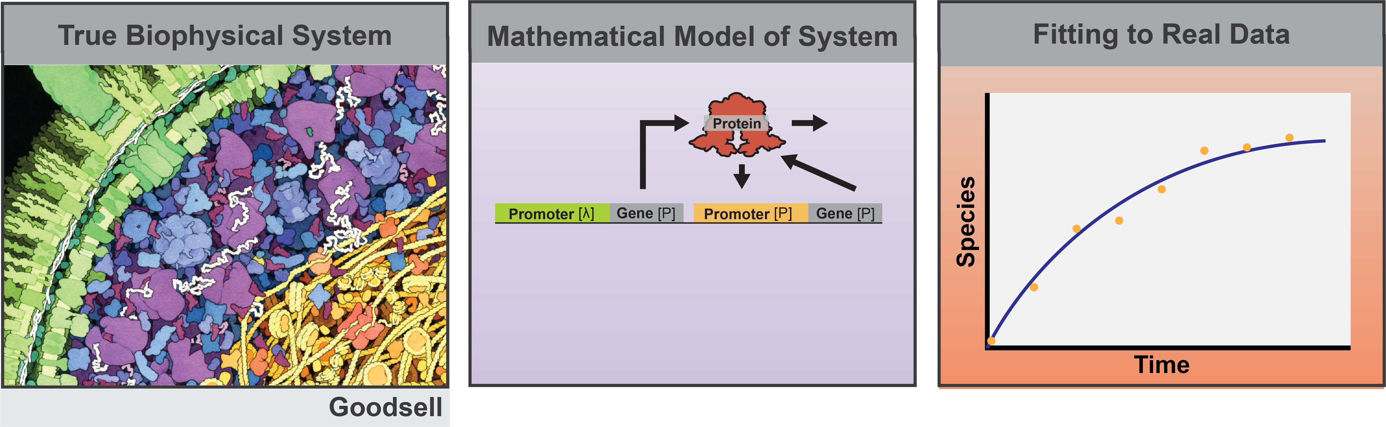
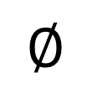
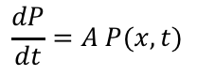
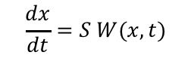
Motivation: What are models good for?
Outline
Motivation & Intro
Mechanistic Model
Reaction Stoichiometry
Reaction Propensity
Law of Mass Action
Putting it all Together
Final Notes
Example 1
Example 2
Example 3
Example 4
What are dynamic models useful for in biological processes?
Mechanistic underpinning of real data
Predictive power in new circumstances
Biophysical based analysis
Biophysical System
$$∅$$
#
Stoichiometry=[ … ]
Propensity=[ … ]
$$\frac{dx}{dt}=S W(x,t)$$
$$\frac{dP}{dt}=A P(x,t)$$
Many biological data can be explained by using deterministic or stochastic formulations of chemical reactions using the law of mass action!

Slide 4
Motivation
Outline
Motivation & Intro
Mechanistic Model
Reaction Stoichiometry
Reaction Propensity
Law of Mass Action
Putting it all Together
Final Notes
Example 1
Example 2
Example 3
Example 4
What changes in a dynamic chemical system?
Reactions have a propensity to cause a change in species count according to the stoichiometry of the system
The propensity to react changes depending on the instantaneous state of the system
The stoichiometry of a reaction tell us how each reaction changes on the number of species in the system
What is a ’model’?
A model is a combination of both stoichiometry, and propensity which can be used to capture the dynamics of a biological system
Model time dynamics can be analyzed using differential equations, stochastic simulation algorithms and chemical master equations

Slide 5
Motivation:
Outline
Motivation & Intro
Mechanistic Model
Reaction Stoichiometry
Reaction Propensity
Law of Mass Action
Putting it all Together
Final Notes
Example 1
Example 2
Example 3
Example 4
Different levels of model detail give arise to different levels of accuracy and complexity
 | Deterministic Analysis | Stochastic Analysis
Mixed Models | Ordinary Differential Equation | Chemical Master Equation Stochastic Simulation Alg.
Compartmental Models | System of Ordinary Differential Equations | Chemical Master Equation Stochastic Simulation Alg.
Spatial Models | Partial Differential Equations | Reaction-Diffusion Master Equation
Less Detail
Mid Detail
More Detail
Mixed models assume the the space where the chemical reactions occur are well mixed
Compartmental models break down the space into a set of compartments
Spatial models assume that each point in space has an associated local concentration

Slide 6
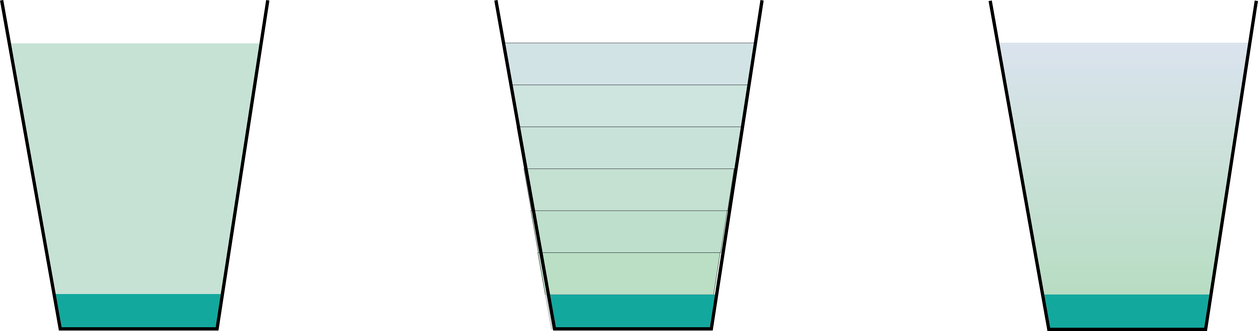
Motivation:
Outline
Motivation & Intro
Mechanistic Model
Reaction Stoichiometry
Reaction Propensity
Law of Mass Action
Putting it all Together
Final Notes
Example 1
Example 2
Example 3
Example 4
Example:
Modeling how sugar dissolves in a cup in 3 different ways
Mixed Model
Compartmental Model
Spatial Model
Mixed Model: One value for concentration everywhere
Compartmental Model: Different compartments share the same concentration
Spatial Model: Every point in space has its own concentration

Slide 7
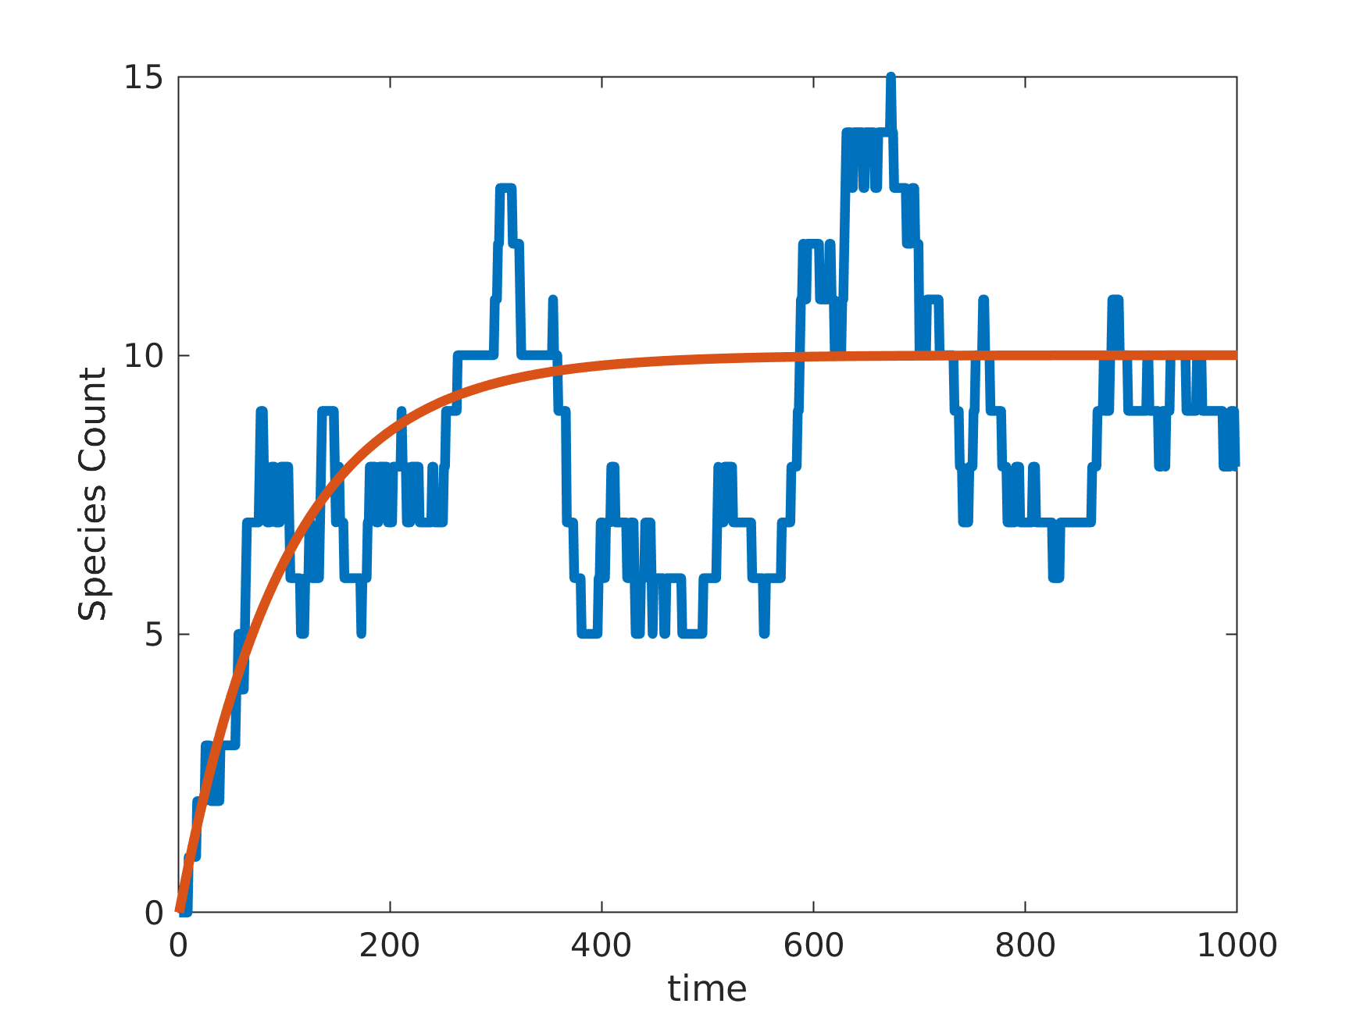
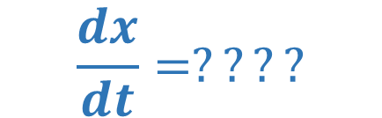
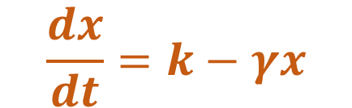
Intro- Deterministic vs Stochastic Models
Outline
Motivation & Intro
Mechanistic Model
Reaction Stoichiometry
Reaction Propensity
Law of Mass Action
Putting it all Together
Final Notes
Example 1
Example 2
Example 3
Example 4
Ordinary Differential Equations (ODE’s) are used to solve a model.
ODE modeling methods for chemical reactions do not work well to model noise
$$\frac{dx}{dt}=k−γx$$
$$\frac{dx}{dt}=????$$
Where ODEs can be misleading:
Molecule counts aren’t continuous, especially for small volumes like cells
Real systems exhibit fluctuations
Learning Objectives
Learning objectives for this lecture:
Learn to define propensity functions and stoichiometry vectors for chemical reactions
Learn how to use the law of mass action to estimate propensity functions

Slide 8
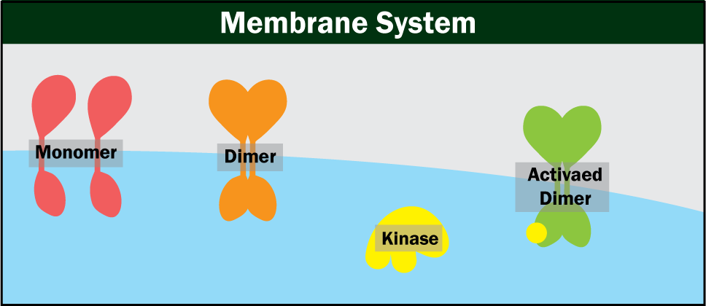
Making chemical reaction sets out of mechanistic models
Outline
Motivation & Intro
Mechanistic Model
Reaction Stoichiometry
Reaction Propensity
Law of Mass Action
Putting it all Together
Final Notes
Example 1
Example 2
Example 3
Example 4
Example: Model for membrane dimerization
General Biological Process:
Monomers are brought to the cell membrane
Monomers can dimerize into dimers
Dimers become phosphorylated and become active dimers
How would you model this using Spatial, Compartmental, or well-mixed?
How would you model this using deterministic vs stochastic assumptions?

Slide 9
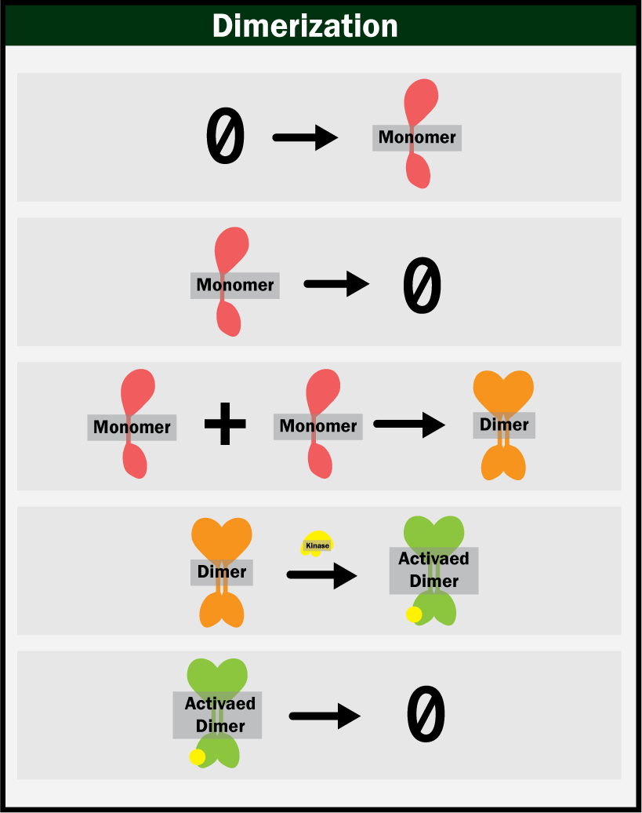
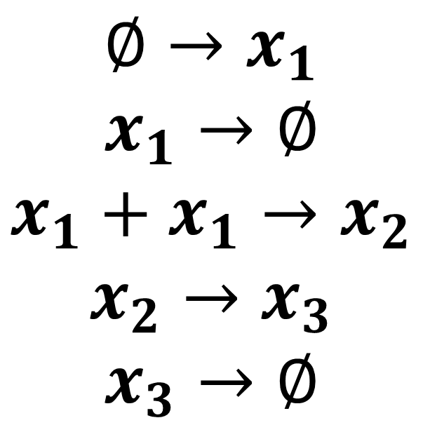
Making chemical reactions out of models
Outline
Motivation & Intro
Mechanistic Model
Reaction Stoichiometry
Reaction Propensity
Law of Mass Action
Putting it all Together
Final Notes
Example 1
Example 2
Example 3
Example 4
Break down the system into five reactions
$$∅→x_{1}$$
$$x_{1}→∅$$
$$x_{1}+x_{1}→x_{2}$$
$$x_{2}→x_{3}$$
$$x_{3}→∅$$

Slide 10
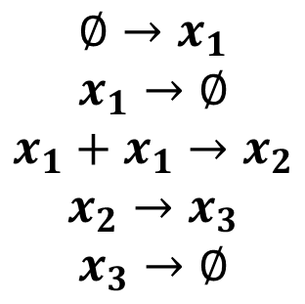
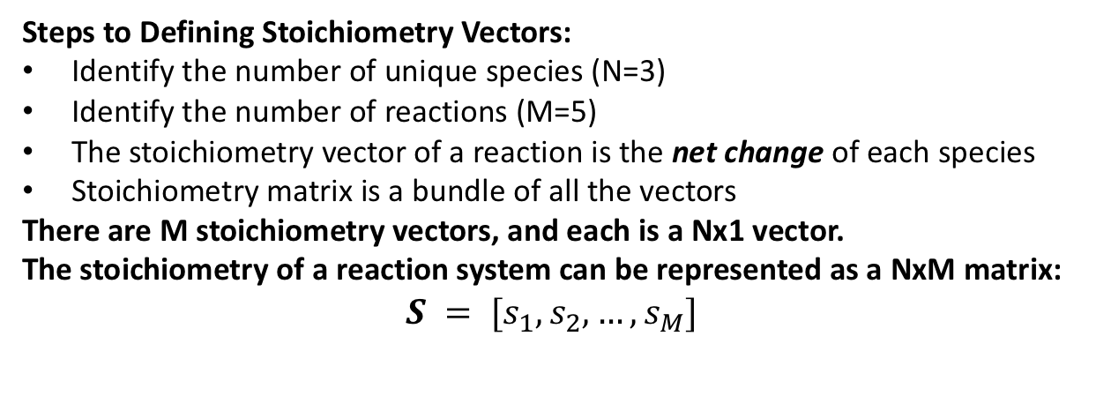
Reaction Stoichiometry
Outline
Motivation & Intro
Mechanistic Model
Reaction Stoichiometry
Reaction Propensity
Law of Mass Action
Putting it all Together
Final Notes
Example 1
Example 2
Example 3
Example 4
The stoichiometry matrix shows the net change in molecule count after each reaction
Steps to Defining Stoichiometry Vectors:
Identify the number of unique species (N=3)
Identify the number of reactions (M=5)
The stoichiometry vector of a reaction is the net change of each species
Stoichiometry matrix is a bundle of all the vectors
There are M stoichiometry vectors, and each is a Nx1 vector.
The stoichiometry of a reaction system can be represented as a NxM matrix:
$$S = [s_{1}, s_{2}, …, s_{M}]$$
$$∅→x_{1}$$
$$x_{1}→∅$$
$$x_{1}+x_{1}→x_{2}$$
$$x_{2}→x_{3}$$
$$x_{3}→∅$$
Write the Stoichiometry matrix for the chemical reaction set above.

Slide 11
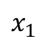
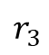
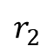
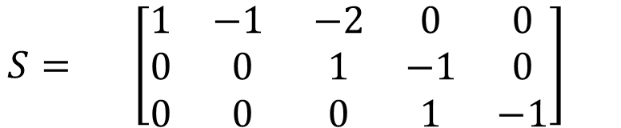
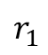
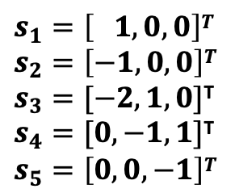
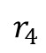
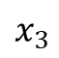
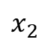
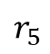
Reaction Stoichiometry
Outline
Motivation & Intro
Mechanistic Model
Reaction Stoichiometry
Reaction Propensity
Law of Mass Action
Putting it all Together
Final Notes
Example 1
Example 2
Example 3
Example 4
The stoichiometry matrix shows the net change in molecule count after each reaction
Steps to Defining Stoichiometry Vectors:
Identify the number of unique species (N=3)
Identify the number of reactions (M=5)
The stoichiometry vector of a reaction is the net change of each species
Stoichiometry matrix is a bundle of all the vectors
There are M stoichiometry vectors, and each is a Nx1 vector.
The stoichiometry of a reaction system can be represented as a NxM matrix:
$$S = [s_{1}, s_{2}, …, s_{M}]$$
$$∅→x_{1}$$
$$x_{1}→∅$$
$$x_{1}+x_{1}→x_{2}$$
$$x_{2}→x_{3}$$
$$x_{3}→∅$$
Write the Stoichiometry matrix for the chemical reaction set above.
$$r_{1}$$
$$r_{2}$$
$$r_{3}$$
$$r_{4}$$
$$r_{5}$$
$$s_{1}=\left[ 1, 0, 0\right]T$$
$$s_{2}=\left[−1, 0, 0\right]T$$
$s_{3}=[−2, 1, 0]$^{T}
$s_{4}=[0, −1,1]$^{T}
$$s_{5}=\left[0, 0, −1\right]T$$
$$x_{1}$$
$$\begin{matrix}S= \left[\begin{matrix}1 & −1 & −2 & 0 & 0 \\ 0 & 0 & 1 & −1 & 0 \\ 0 & 0 & 0 & 1 & −1\end{matrix}\right] & \end{matrix}$$
Rows are the species
Columns are the reactions
$$x_{2}$$
$$x_{3}$$

Slide 12
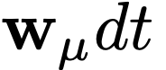
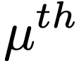
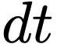
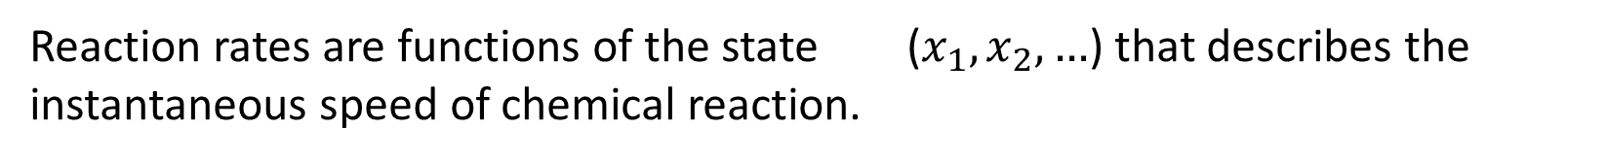
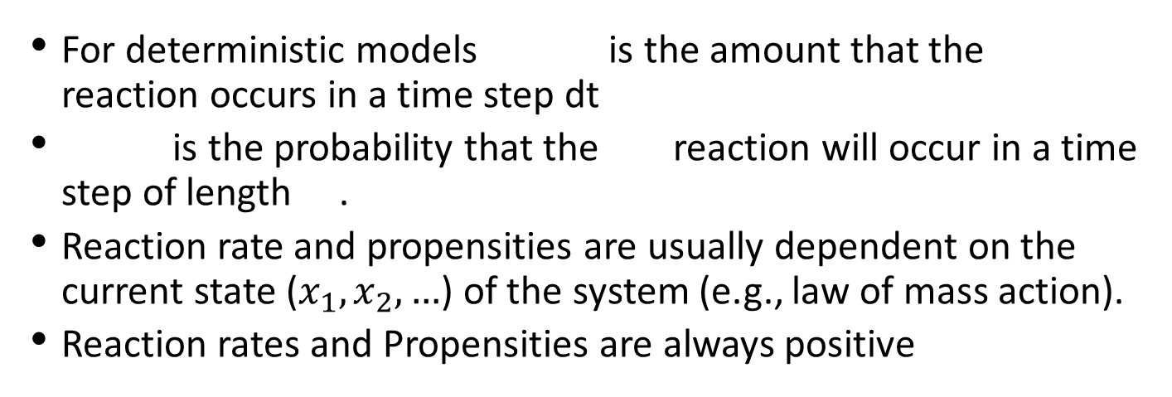
Reaction Rates and Propensity Functions
Outline
Motivation & Intro
Mechanistic Model
Reaction Stoichiometry
Reaction Propensity
Law of Mass Action
Putting it all Together
Final Notes
Example 1
Example 2
Example 3
Example 4
Reaction rates are functions of the state ($x_{1},x_{2},…$) that describes the instantaneous speed of chemical reaction.
For deterministic models is the amount that the reaction occurs in a time step dt
is the probability that the reaction will occur in a time step of length .
Reaction rate and propensities are usually dependent on the current state ($x_{1},x_{2},…$) of the system (e.g., law of mass action).
Reaction rates and Propensities are always positive
[9, 15]
[10, 15]
[11, 15]
[12, 15]
[9, 14]
[10, 14]
[11, 14]
[12, 14]
Reaction rates and propensities depend on the current state

Slide 13
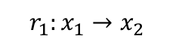
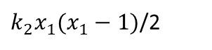
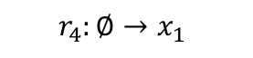
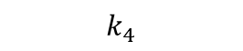
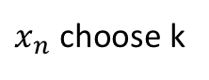
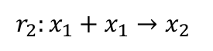
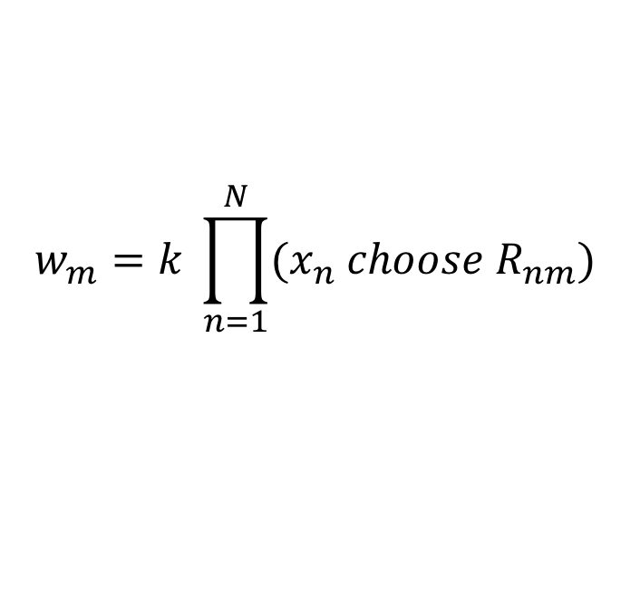
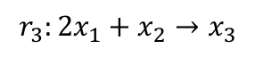
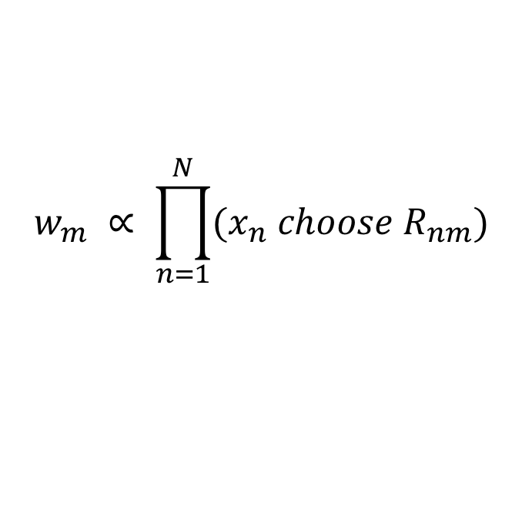
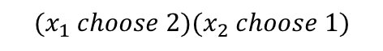
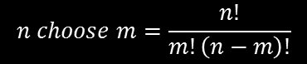
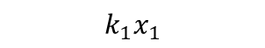
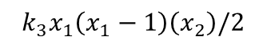
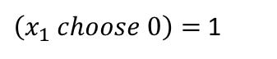
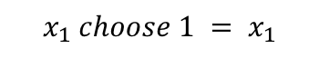
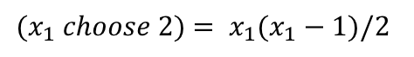
Law of Mass Action
Outline
Motivation & Intro
Mechanistic Model
Reaction Stoichiometry
Reaction Propensity
Law of Mass Action
Putting it all Together
Final Notes
Example 1
Example 2
Example 3
Example 4
The law of mass action states that the rate of a chemical reaction is proportional to the number of unique combinations by which reactants can combine to form the products:
$$w_{m} ∝ \prod_{n=1}^{N}{(x_{n} choose R_{nm})}$$
$$w_{m}=k \prod_{n=1}^{N}{(x_{n} choose R_{nm})}$$
where $R_{nm}$ is the number of reactant molecules of species n needed for the m^{th} reaction and k arbitrary
Reaction
$x_{n}$ choose k
Propensity equation
$$n choose m=\frac{n!}{m!\left(n−m\right)!}$$
$$r_{1}:x_{1}→x_{2}$$
$$x_{1} choose 1 = x_{1}$$
$$k_{1}x_{1}$$
$$r_{2}:x_{1}+x_{1}→x_{2}$$
$(x_{1} choose 2)$ $= x_{1}(x_{1}−1)/2$
$k_{2}x_{1}(x_{1}−1)$/2
$$r_{3}:{2x}_{1}+x_{2}→x_{3}$$
$$(x_{1} choose 2)(x_{2} choose 1)$$
$$k_{3}x_{1}\left(x_{1}−1\right)\left(x_{2}\right)/2$$
$$r_{4}:∅→x_{1}$$
$\left(x_{1} choose 0\right)=$ 1
$$k_{4}$$
When x is large, x(x-1) is approximately equal to x². This is the common form of mass action for ODE analyses.
When x is small (integer copy numbers), the effect of finite molecule counts is far more important.
k is an arbitrary proportionality coefficient – in many applications, the integer in the denominator of the combinatorial is lumped into this constant.
Propensity functions depend only on the reactants – the products are irrelevant.

Slide 14
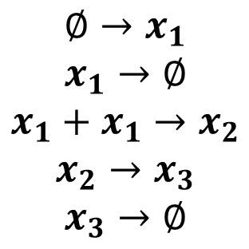
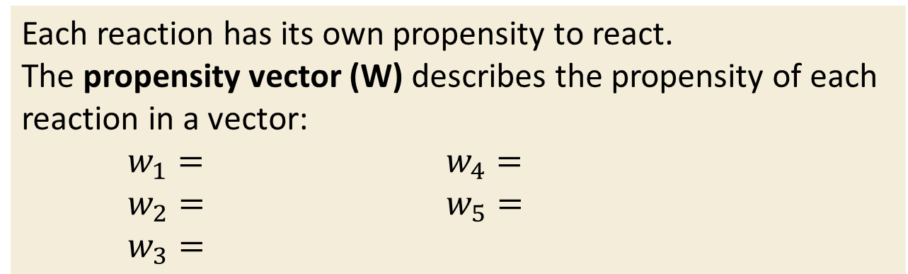
Reaction Propensity
Outline
Motivation & Intro
Mechanistic Model
Reaction Stoichiometry
Reaction Propensity
Law of Mass Action
Putting it all Together
Final Notes
Example 1
Example 2
Example 3
Example 4
Propensity is a function of state and time which describes the instantaneous rate of reaction of chemical reactions
Each reaction has its own propensity to react.
The propensity vector (W) describes the propensity of each reaction in a vector:
$w_{1}=$ $w_{4}=$
$w_{2}=$ $w_{5}=$
$w_{3}=$
$$∅→x_{1}$$
$$x_{1}→∅$$
$$x_{1}+x_{1}→x_{2}$$
$$x_{2}→x_{3}$$
$$x_{3}→∅$$
Use the Law of Mass action to write the propensity of the above reactions.

Slide 15
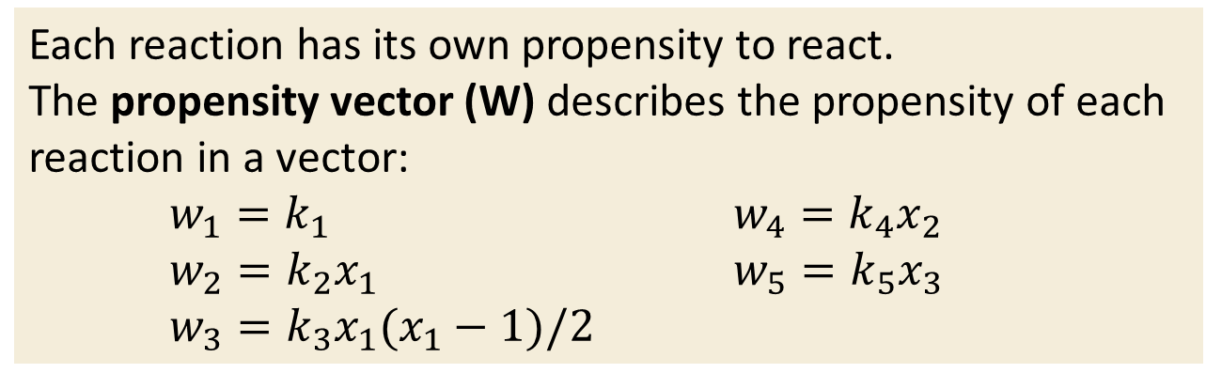
Reaction Propensity
Outline
Motivation & Intro
Mechanistic Model
Reaction Stoichiometry
Reaction Propensity
Law of Mass Action
Putting it all Together
Final Notes
Example 1
Example 2
Example 3
Example 4
Propensity is a function of state and time which describes the instantaneous rate of reaction of chemical reactions
Each reaction has its own propensity to react.
The propensity vector (W) describes the propensity of each reaction in a vector:
$w_{1}=k_{1}$ $w_{4}=k_{4}x_{2}$
$w_{2}=k_{2}x_{1}$ $w_{5}=k_{5}x_{3}$
$w_{3}=k_{3}x_{1}(x_{1}−1)/2$
$$∅→x_{1}$$
$$x_{1}→∅$$
$$x_{1}+x_{1}→x_{2}$$
$$x_{2}→x_{3}$$
$$x_{3}→∅$$
Use the Law of Mass action to write the propensity of the above reactions.

Slide 16



Reaction Propensity
Outline
Motivation & Intro
Mechanistic Model
Reaction Stoichiometry
Reaction Propensity
Law of Mass Action
Putting it all Together
Final Notes
Example 1
Example 2
Example 3
Example 4
Propensity is a function of state and time which describes the instantaneous rate of reaction of chemical reactions
Each reaction has its own propensity to react.
The propensity vector (W) describes the propensity of each reaction in a vector:
$w_{1}=k_{1}$ $w_{4}=k_{4}x_{2}$
$w_{2}=k_{2}x_{1}$ $w_{5}=k_{5}x_{3}$
$w_{3}=k_{3}x_{1}(x_{1}−1)/2$
$$∅→x_{1}$$
$$x_{1}→∅$$
$$x_{1}+x_{1}→x_{2}$$
$$x_{2}→x_{3}$$
$$x_{3}→∅$$
Use the Law of Mass action to write the propensity of the above reactions.
$$w_{1}(x,t)=k_{1}$$
$$w_{2}(x,t)=k_{2}x_{1}$$
$w_{3}(x,t)=k_{3}(x_{1})(x_{1}−1)$/2
$$w_{4}(x,t)=k_{4}x_{2}$$
$$w_{5}(x,t)=k_{5}x_{3}$$
$$W\left(x,t\right)=\left[\begin{matrix}k_{1} \\ \begin{matrix}k_{2}x_{1} \\ k_{3}(x_{1})(x_{1}−1)/2 \\ k_{4}x_{2}\end{matrix} \\ k_{5}x_{3}\end{matrix}\right]$$
or $W′\left(x,t\right)=\left[\begin{matrix}k_{1} \\ \begin{matrix}k_{2}x_{1} \\ {k′}_{3}(x_{1})(x_{1}−1) \\ k_{4}x_{2}\end{matrix} \\ k_{5}x_{3}\end{matrix}\right]$

Slide 17






Putting it all together
Outline
Motivation & Intro
Mechanistic Model
Reaction Stoichiometry
Reaction Propensity
Law of Mass Action
Putting it all Together
Final Notes
Example 1
Example 2
Example 3
Example 4
The “mean field” ODE description for the instantaneous rate of change of the average system is given by:
$$\frac{dx}{dt}=S W(x,t)$$
$$W\left(x,t\right)=\left[\begin{matrix}k_{1} \\ \begin{matrix}k_{2}x_{1} \\ {k′}_{3}(x_{1})(x_{1}−1) \\ k_{4}x_{2}\end{matrix} \\ k_{5}x_{3}\end{matrix}\right]$$
$$\begin{matrix}S=\left[\begin{matrix}1 & −1 & −2 & 0 & 0 \\ 0 & 0 & 1 & −1 & 0 \\ 0 & 0 & 0 & 1 & −1\end{matrix}\right] & \end{matrix}$$
Write the equation for $\frac{dx}{dt}$ given the S and W defined above.
$$\frac{dx_{1}}{dt}=$$
$$\frac{dx_{2}}{dt}=$$
$$\frac{dx_{3}}{dt}=$$

Slide 18




Putting it all together
Outline
Motivation & Intro
Mechanistic Model
Reaction Stoichiometry
Reaction Propensity
Law of Mass Action
Putting it all Together
Final Notes
Example 1
Example 2
Example 3
Example 4
The “mean field” ODE description for the instantaneous rate of change of the average system is given by:
$$\frac{dx}{dt}=S W(x,t)$$
$$W\left(x,t\right)=\left[\begin{matrix}k_{1} \\ \begin{matrix}k_{2}x_{1} \\ {k′}_{3}(x_{1})(x_{1}−1) \\ k_{4}x_{2}\end{matrix} \\ k_{5}x_{3}\end{matrix}\right]$$
$$\begin{matrix}S=\left[\begin{matrix}1 & −1 & −2 & 0 & 0 \\ 0 & 0 & 1 & −1 & 0 \\ 0 & 0 & 0 & 1 & −1\end{matrix}\right] & \end{matrix}$$
Write the equation for $\frac{dx}{dt}$ given the S and W defined above.
$$\frac{dx_{1}}{dt}=k_{1}−k_{2}x_{1}−2{k^{′}}_{3}x_{1}(x_{1}−1)$$
$$\frac{dx}{dt}=\left[\begin{matrix}k_{1}−k_{2}x_{1}−2{k^{′}}_{3}x_{1}(x_{1}−1) \\ {k^{′}}_{3}x_{1}\left(x_{1}−1\right)−k_{4}x_{2} \\ k_{4}x_{2}−k_{5}x_{3} \end{matrix}\right]$$
$$\frac{dx_{2}}{dt}={k^{′}}_{3}x_{1}\left(x_{1}−1\right)−k_{4}x_{2}$$
$$\frac{dx_{3}}{dt}=k_{4}x_{2}−k_{5}x_{3}$$

Slide 19




Putting it all together
Outline
Motivation & Intro
Mechanistic Model
Reaction Stoichiometry
Reaction Propensity
Law of Mass Action
Putting it all Together
Final Notes
Example 1
Example 2
Example 3
Example 4
The ODE description for the instantaneous rate of change of the entire system is given by:
$$\frac{dx}{dt}=S W(x,t)$$
$$W′\left(x,t\right)=\left[\begin{matrix}k_{1} \\ \begin{matrix}k_{2}x_{1} \\ {k′}_{3}(x_{1})(x_{1}−1) \\ k_{4}x_{2}\end{matrix} \\ k_{5}x_{3}\end{matrix}\right]$$
$$\begin{matrix}S=\left[\begin{matrix}1 & −1 & −2 & 0 & 0 \\ 0 & 0 & 1 & −1 & 0 \\ 0 & 0 & 0 & 1 & −1\end{matrix}\right] & \end{matrix}$$
$\frac{dx}{dt}$ can be integrated numerically to solve for the ODE solution of the model.
scipy.integrate.odeint

Slide 20








Final Notes: Reaction Stoichiometry
Outline
Motivation & Intro
Mechanistic Model
Reaction Stoichiometry
Reaction Propensity
Law of Mass Action
Putting it all Together
Final Notes
Example 1
Example 2
Example 3
Example 4
The stoichiometry only measures the net change (increase in products –decrease in reactants), whereas propensities depend only on reactants.
For this reason, the same stoichiometry can correspond to many different propensity functions.
Stoichiometry should not be used to guess the propensity – nor vice-versa!

Slide 21




















Final Notes: Reducing Model Size Using Separation of Timescales
Outline
Motivation & Intro
Mechanistic Model
Reaction Stoichiometry
Reaction Propensity
Law of Mass Action
Putting it all Together
Final Notes
Example 1
Example 2
Example 3
Example 4
Is the law of mass action required for the definition of propensity functions?
Michaelis-Menten Dynamics:
Michaelis-Menten Full Dynamics
$$+$$
$$→$$
$$→$$
$$+$$
$$→$$
Propensity is always given by
Law of Mass Action
Quasi-steady equilibrium:
$$k_{1}x_{1}x_{2} = k_{2}x_{3}$$
$$x_{1}:Enzyme$$
$$x_{2}:Substrate$$
$$x_{3}:Enzyme Substrate Complex$$
$$x_{4}:Product$$
$$r_{1}: x_{1}+x_{2}→x_{3}$$
$$w_{1}= {k_{1}x}_{1}x_{2}$$
$$r_{2}: {x_{3}→x}_{1}+x_{2}$$
$$w_{2}={ k}_{2}x_{3}$$
Enzyme is Conserved:
$$x_{1}+x_{3} = E_{T}$$
$$r_{3}: {x_{3}→x}_{1}+x_{4}$$
$$w_{3}={ k}_{3}x_{3}$$
$$r_{4}: x_{4}→∅$$
$$w_{4}={ k}_{4}$$
Law of Mass action is always correct for a completely modeled system, but model simplifications can lead to different propensities not given by law of mass action
Notes:
Break up this slide into more parts

Slide 22










Final Notes: Reducing Model Size Using Separation of Timescales
Outline
Motivation & Intro
Mechanistic Model
Reaction Stoichiometry
Reaction Propensity
Law of Mass Action
Putting it all Together
Final Notes
Example 1
Example 2
Example 3
Example 4
Is the law of mass action required for the definition of propensity functions?
Michaelis-Menten Dynamics:
Simplified Dynamics
$$+$$
$$→$$
$$→$$
Allows for model simplification
$$→$$
Quasi-steady equilibrium:
$$k_{1}x_{1}x_{2} = k_{2}x_{3}$$
Propensity appears
to be complex
$$x_{1}:Substrate$$
$$x_{2}:Product$$
Enzyme is Conserved:
$$x_{1}+x_{3} = E_{T}$$
$${w′}_{1}=\frac{k_{3}{k_{1}E}_{T}x_{1}}{k_{1}x_{1}+k_{2}}$$
$$r_{1}: x_{1}→x_{2}$$
$$r_{2}: x_{2}→∅$$
$$w_{3}={ k}_{3}x_{3}$$
Law of Mass action is always correct for a completely modeled system, but model simplifications can lead to different propensities not given by law of mass action
Notes:
Break up this slide into more parts

Slide 23








Final Notes: Reducing Model Size Using Separation of Timescales
Outline
Motivation & Intro
Mechanistic Model
Reaction Stoichiometry
Reaction Propensity
Law of Mass Action
Putting it all Together
Final Notes
Example 1
Example 2
Example 3
Example 4
Is the law of mass action required for the definition of propensity functions?
Michaelis-Menten Dynamics:
Michaelis-Menten Full Dynamics
Simplified Dynamics
$$+$$
$$→$$
$$→$$
$$+$$
$$→$$
$$→$$
Propensity is always given by
Law of Mass Action
Propensity appears
to be complex
Quasi-steady equilibrium:
$$k_{1}x_{1}x_{2} = k_{2}x_{3}$$
$$r_{1}: x_{1}+x_{2}→x_{3}$$
$$w_{1}= {k_{1}x}_{1}x_{2}$$
$${w′}_{1}=\frac{k_{3}{k_{1}E}_{T}x_{1}}{k_{1}x_{1}+k_{2}}$$
$$r_{2}: {x_{3}→x}_{1}+x_{2}$$
$$w_{2}={ k}_{2}x_{3}$$
$$r_{1}: x_{1}→x_{2}$$
$$w_{3}={ k}_{3}x_{3}$$
Enzyme is Conserved:
$$x_{1}+x_{3} = E_{T}$$
$$r_{3}: {x_{3}→x}_{1}+x_{4}$$
$$r_{4}: x_{4}→∅$$
$$w_{4}={ k}_{4}$$
$$r_{2}: x_{2}→∅$$
$$w_{3}={ k}_{3}x_{3}$$
Law of Mass action is always correct for a completely modeled system, but model simplifications can lead to different propensities not given by law of mass action
Notes:
Break up this slide into more parts

Slide 24



Example 1: Birth Decay Process
Outline
Motivation & Intro
Mechanistic Model
Reaction Stoichiometry
Reaction Propensity
Law of Mass Action
Putting it all Together
Final Notes
Example 1
Example 2
Example 3
Example 4
$$x_{1}:Protein$$
$${r_{1}: ∅→x}_{1}$$
$${r_{2}: x}_{1}→∅$$

Slide 25







Example 1: Birth Decay Process
Outline
Motivation & Intro
Mechanistic Model
Reaction Stoichiometry
Reaction Propensity
Law of Mass Action
Putting it all Together
Final Notes
Example 1
Example 2
Example 3
Example 4
$${r_{1}: ∅→x}_{1}$$
$${r_{2}: x}_{1}→∅$$
$$x_{1}:Protein$$
$$s_{1}: [ 1]$$
$$s_{2}: [−1]$$
$$w_{1}: k_{1}$$
$$w_{2}: k_{2}x_{1}$$
$$W(x,t)=\left[\begin{matrix}k_{1} \\ k_{2}x_{1}\end{matrix}\right]$$
$\frac{dx}{dt}=$ $k_{1}$- $k_{2}x_{1}$
$$S=[\begin{matrix}1, & −1\end{matrix}]$$

Slide 26



Reaction Set
Stoich. Vectors
Propensity
Example 2: Bursting Gene Expression
Outline
Motivation & Intro
Mechanistic Model
Reaction Stoichiometry
Reaction Propensity
Law of Mass Action
Putting it all Together
Final Notes
Example 1
Example 2
Example 3
Example 4
$${r_{1}: x_{1}→x}_{2}$$
$${r_{2}: x}_{2}→x_{1}$$
$${r_{3}: x_{2}→x_{2}+x}_{3}$$
$${r_{4}: x}_{3}→∅$$
$$x_{1}:Gene OFF$$
$$x_{2}:Gene ON$$
$$x_{3}:Protein$$

Slide 27





Reaction Set
Stoich. Vectors
Propensity
Example 2: Bursting Gene Expression
Outline
Motivation & Intro
Mechanistic Model
Reaction Stoichiometry
Reaction Propensity
Law of Mass Action
Putting it all Together
Final Notes
Example 1
Example 2
Example 3
Example 4
$${r_{1}: x_{1}→x}_{2}$$
$${r_{2}: x}_{2}→x_{1}$$
$${r_{3}: x_{2}→x_{2}+x}_{3}$$
$${r_{4}: x}_{3}→∅$$
$$x_{1}:Gene OFF$$
$$x_{2}:Gene ON$$
$$x_{3}:Protein$$
$$s_{1}: \left[−1, 1,0 \right]$$
$$s_{2}: \left[1, −1, 0\right]$$
$$s_{3}: [ 0, 0 ,1]$$
$$s_{4}: [ 0, 0,−1]$$
$$w_{1}: k_{1}x_{1}$$
$$w_{2}: k_{2}x_{2}$$
$$w_{3}: k_{3}x_{2}$$
$$w_{4}: k_{4}x_{3}$$
$$W(x,t)=\left[\begin{matrix}\begin{matrix}k_{1}x_{1} \\ {k_{2}x}_{2}\end{matrix} \\ \begin{matrix}k_{3}x_{2} \\ k_{4}x_{3}\end{matrix}\end{matrix}\right]$$
$$\frac{dx}{dt}=\left[\begin{matrix}\begin{matrix}{−k}_{1}x_{1}+{k_{2}x}_{2} \\ {{k_{1}x_{1}−k}_{2}x}_{2}\end{matrix} \\ k_{3}x_{2}−k_{4}x_{3}\end{matrix}\right]$$
$$S=\left[\begin{matrix}−1 & 1 & 0 & 0 \\ 1 & −1 & 0 & 0 \\ 0 & 0 & 1 & −1\end{matrix}\right]$$

Slide 28






Example 4: Stochastic Oscillator
Outline
Motivation & Intro
Mechanistic Model
Reaction Stoichiometry
Reaction Propensity
Law of Mass Action
Putting it all Together
Final Notes
Example 1
Example 2
Example 3
Example 4
$${r_{1}: x_{1}→x}_{2}$$
$${r_{2}: x}_{2}→x_{1}$$
$${r_{3}: x_{2}→x_{2}+x}_{3}$$
$${r_{4}: x}_{3}→∅$$
$$w_{1}:x_{1}x_{3}^{k_{1}}/{(k}_{2}^{k_{1}}+x_{3}^{k_{1}})$$
$$w_{2}:k_{2}x_{2}/(1+x_{3}^{k_{1}})$$
$$w_{3}: k_{3}x_{2}$$
$$w_{4}: k_{5}x_{3}$$

Slide 29






Example 4: Stochastic Oscillator
Outline
Motivation & Intro
Mechanistic Model
Reaction Stoichiometry
Reaction Propensity
Law of Mass Action
Putting it all Together
Final Notes
Example 1
Example 2
Example 3
Example 4
$$w_{1}:x_{1}x_{3}^{k_{1}}/{(k}_{2}^{k_{1}}+x_{3}^{k_{1}})$$
$${r_{1}: x_{1}→x}_{2}$$
$${r_{2}: x}_{2}→x_{1}$$
$${r_{3}: x_{2}→x_{2}+x}_{3}$$
$${r_{4}: x}_{3}→∅$$
$$w_{2}:k_{2}x_{2}/(1+x_{3}^{k_{1}})$$
$$w_{3}: k_{3}x_{2}$$
$$w_{4}: k_{5}x_{3}$$
$$W(x,t)=\left[\begin{matrix}\begin{matrix}x_{1}x_{3}^{k_{1}}/{(k}_{2}^{k_{1}}+x_{3}^{k_{1}}) \\ k_{2}x_{2}/(1+x_{3}^{k_{1}}) \end{matrix} \\ \begin{matrix}k_{3}x_{2} \\ k_{5}x_{3} \end{matrix}\end{matrix}\right]$$
$$S=\left[\begin{matrix}\begin{matrix}−1 \\ \begin{matrix}1 \\ 0\end{matrix}\end{matrix} & \begin{matrix}1 \\ \begin{matrix}−1 \\ 0\end{matrix}\end{matrix}\end{matrix} \begin{matrix}\begin{matrix}0 \\ \begin{matrix}0 \\ 1\end{matrix}\end{matrix} & \begin{matrix}0 \\ \begin{matrix}0 \\ −1\end{matrix}\end{matrix}\end{matrix}\right]$$
$$\frac{dx}{dt}=\left[\begin{matrix}\begin{matrix}\frac{k_{2}x_{2}}{1+x_{3}^{k_{1}}}−x_{1}x_{3}^{k_{1}}/{(k}_{2}^{k_{1}}+x_{3}^{k_{1}}) \\ x_{1}x_{3}^{k_{1}}/{(k}_{2}^{k_{1}}+x_{3}^{k_{1}})−k_{2}x_{2}/(1+x_{3}^{k_{1}})\end{matrix} \\ k_{3}x_{2}−k_{5}x_{3}\end{matrix}\right]$$

Slide 30

Example 3: Genetic Toggle
Outline
Motivation & Intro
Mechanistic Model
Reaction Stoichiometry
Reaction Propensity
Law of Mass Action
Putting it all Together
Final Notes
Example 1
Example 2
Example 3
Example 4

Slide 31






Example 3: Genetic Toggle
Outline
Motivation & Intro
Mechanistic Model
Reaction Stoichiometry
Reaction Propensity
Law of Mass Action
Putting it all Together
Final Notes
Example 1
Example 2
Example 3
Example 4
$${r_{1}: ∅→x}_{1}$$
$${r_{2}: x}_{1}→∅$$
$${r_{3}: ∅→x}_{2}$$
$${r_{4}: x}_{2}→∅$$
$$s_{1}: {\left[ 1, 0\right]}^{T}$$
$$s_{2}: {\left[−1, 0\right]}^{T}$$
$$s_{3}: {\left[ 0, 1\right]}^{T}$$
$$s_{4}: {\left[ 0,−1\right]}^{T}$$
$$w_{1}:k_{1}+k_{2}/(1+k_{3}x_{2}^{k_{4}})$$
$$w_{2}:k_{5}x_{1}$$
$$w_{3}:k_{6}+k_{7}/(1+k_{8}x_{1}^{k_{9}})$$
$$w_{4}:k_{10}x_{2}$$

Slide 32




Example 3: Genetic Toggle
Outline
Motivation & Intro
Mechanistic Model
Reaction Stoichiometry
Reaction Propensity
Law of Mass Action
Putting it all Together
Final Notes
Example 1
Example 2
Example 3
Example 4
$${r_{1}: ∅→x}_{1}$$
$${r_{2}: x}_{1}→∅$$
$${r_{3}: ∅→x}_{2}$$
$${r_{4}: x}_{2}→∅$$
$$s_{1}: {\left[ 1, 0\right]}^{T}$$
$$s_{2}: {\left[−1, 0\right]}^{T}$$
$$s_{3}: {\left[ 0, 1\right]}^{T}$$
$$s_{4}: {\left[ 0,−1\right]}^{T}$$
$$w_{1}:k_{1}+k_{2}/(1+k_{3}x_{2}^{k_{4}})$$
$$w_{2}:k_{5}x_{1}$$
$$w_{3}:k_{6}+k_{7}/(1+k_{8}x_{1}^{k_{9}})$$
$$w_{4}:k_{10}x_{2}$$
$$W(x,t)=\left[\begin{matrix}\begin{matrix}k_{1}+k_{2}/(1+k_{3}x_{2}^{k_{4}}) \\ k_{5}x_{1}\end{matrix} \\ \begin{matrix}k_{6}+k_{7}/(1+k_{8}x_{1}^{k_{9}}) \\ k_{10}x_{2} \end{matrix}\end{matrix}\right]$$
$$\frac{dx}{dt}=\left[\begin{matrix}k_{1}+\frac{k_{2}}{1+k_{3}x_{2}^{k_{4}}}−k_{5}x_{1} \\ k_{6}+\frac{k_{7}}{1+k_{8}x_{1}^{k_{9}}}−k_{10}x_{2}\end{matrix}\right]$$
$$S=\left[\begin{matrix}\begin{matrix}1 \\ 0\end{matrix} & \begin{matrix}−1 \\ 0\end{matrix}\end{matrix} \begin{matrix}\begin{matrix}0 \\ 1\end{matrix} & \begin{matrix}0 \\ −1\end{matrix}\end{matrix}\right]$$

